Slide 1
Interferometry
Kitty Harris and Idriss Kacou

Slide 2
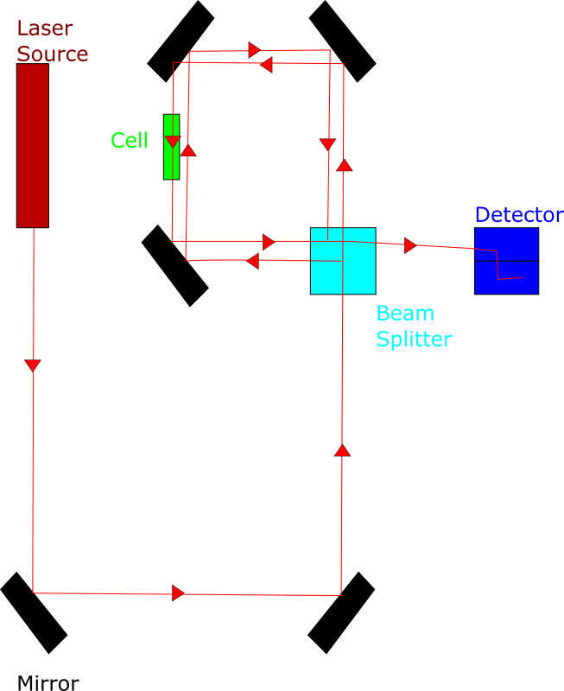
Experimental Setup
Our setup relied on multiple mirrors to direct the beam toward the beam splitter. Past the beam splitter, we used three mirrors at roughly 45˚ angles. There are setups that involve fewer mirrors, but they require more precision to calibrate.

Slide 3
Main Idea: Michelson Interferometer
Beam is split, then recombined.
While the beams are split, one can be altered without altering the other.
Recombination causes interference.
Relating fringe count to change in distance and wavelength allows us to calculate either distance or wavelength.
Effective distance through a gas is dependent on index of refraction, which changes with pressure.
Michelson-Morley experiment popularized the setup
Used to directly observe gravity waves.

Slide 4
Main Idea: Constructive and Destructive interference
The constructive interference happens went the both wave are add to make on wave.
Destructive interference happen went one wave troughs out of phase.
Michelson-Morley experiment used interference to count fringing.
Light have wave like property, so interference have contractive and destructive interference

Slide 5
Equipment: Dielectric vs metal film
There are several kinds of beam splitters. Two methods are to use a dielectric or metal film coating.
The purpose of a beam splitter is to have both a high transmittivity and a high reflectivity so that a beam hitting it at a 45˚ angle will be split into a reflected and transmitted beam.
Dielectric coating is made of several layers of various thickness and materials.
These exploit various indices of refraction to manipulate the way light travels through them.
Dielectric coating layers are generally made of metal oxides.
Minimal effect on polarization
Roughly splits the beam 50/50 in terms of intensity
Usually tuned in to a single wavelength, which is inconvenient for some uses
Metal film, or half-silvered, beam splitters use an extremely thin layer of metal so that there is both significant reflectivity and transmittivity.
Significant loss of intensity
Uneven polarization and splitting
Work for wide bandwidths, which makes them useful favorable when dielectric coatings cannot be used.

Slide 6

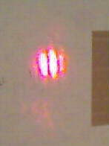


Equipment: Mirror
You can achieve the proper alignment of the mirrors by using metal block
In this experiment the number of bright and dark fringes of the interferometer will be counted in order to measure the path length change due to a moving mirror.
Realigned our interferometer was easy, we realigned every week.
$k=\frac{microns of actual mirror travel }{mictons of travel of the screw threads }$

Slide 7
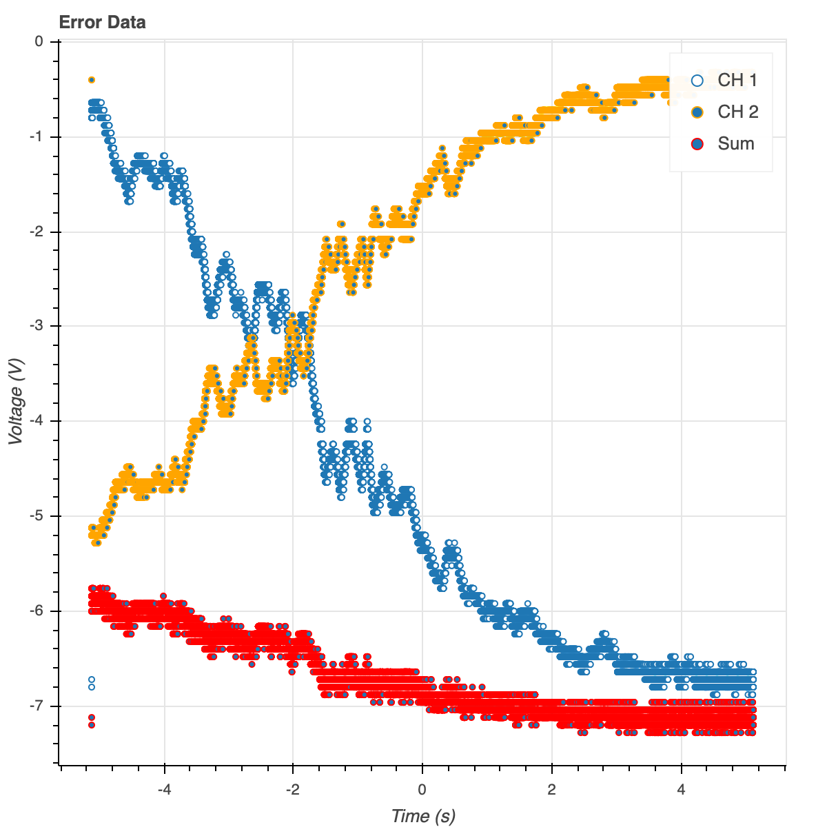
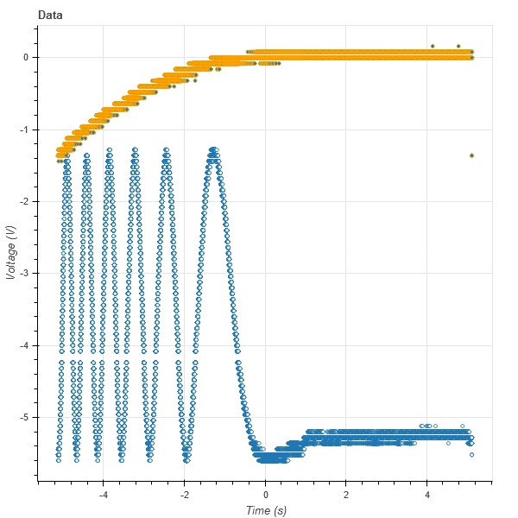
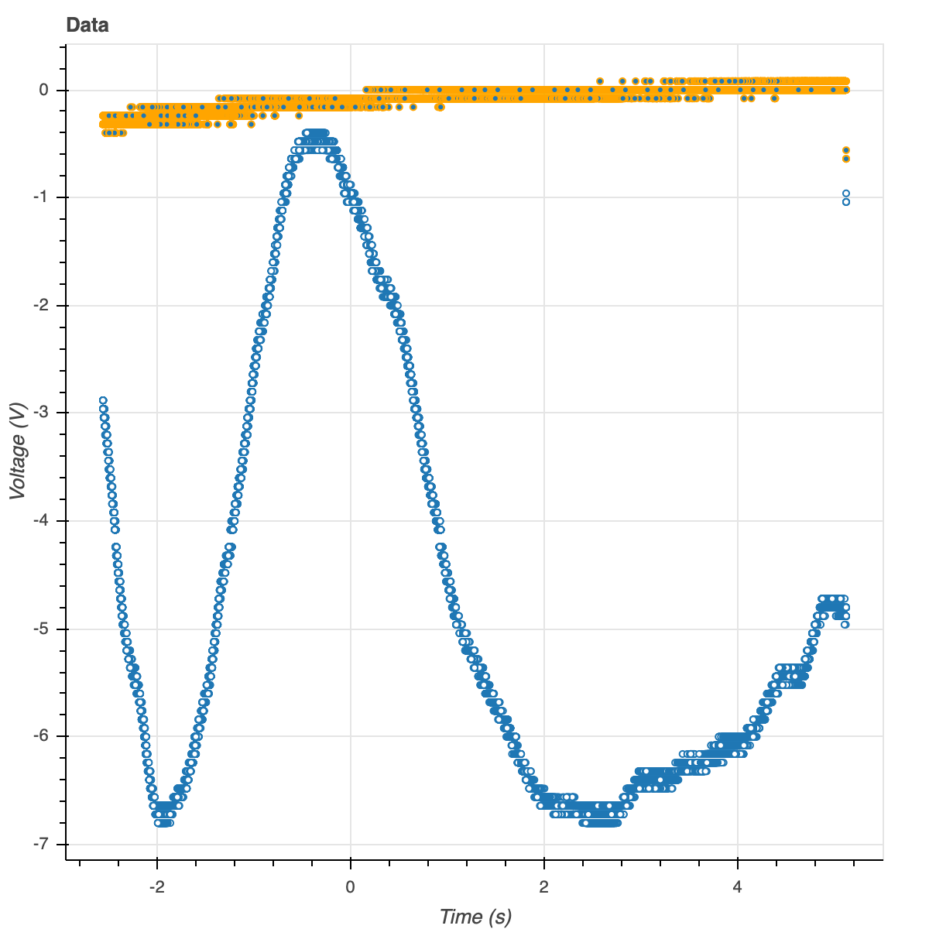

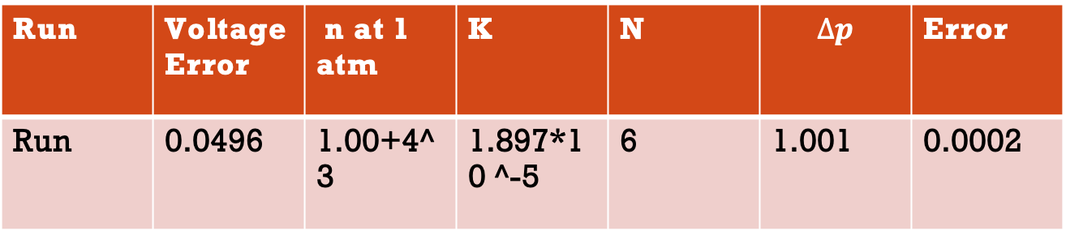
Data Analysis
Fringe count corresponds to the number of peaks or valleys in the optical data.
Wave length= 633nm
10v = 1atm
$$d=\frac{Nλ}{2}$$
$$d=\text{∆}nL$$
$$n=1+kp$$
By solving for k, $n=1+\frac{Nλ}{2L∆p}p$
Run | Voltage Error | n at 1 atm | K | N | $$∆p$$ | Error
Run | 0.0496 | 1.00+4^3 | 1.897*10 ^-5 | 6 | 1.001 | 0.0002

